Slide 1

PREDICTION OF STUDENT PERFORMANCE IN UNIVERSITY ADMISSION SYSTEM
Group 23
TANMAI CHIGILISETTY (811243004)
ANKITH REDDY MORA (811234029)
SAI VAMSI DUDIGAM (811226902)
DURGA TEJASWI GUNNALA (811241484)

Slide 2
ABSTRACT
An admissions system based on valid and reliable admissions criteria is very important to select candidates likely to perform well academically at institutions of higher education. This study focuses on ways to support universities in admissions decision making using data mining techniques to predict applicants’ academic performance at university. The results demonstrate that applicants’ early university performance can be predicted before admission based on certain pre-admission criteria (high school grade average, Scholastic Achievement Admission Test score, and General Aptitude Test score). The results also show that Scholastic Achievement Admission Test score is the pre-admission criterion that most accurately predicts future student performance

Slide 3
INTRODUCTION
Today all higher education institutions, especially computer science and engineering colleges, face challenges in the admissions process. An admission system based on valid and reliable admission criteria is very important to select candidates likely to perform well academically at institutions of higher education. This study focuses on ways to support universities in admissions decision making using Data Mining techniques to predict applicant’s academic performance at university. The results demonstrate that applicant’s early university performance can be predicted before admission based on certain pre-admission criteria which enables students to know prior hand if their level of skills for the placement is enough to get placed or not, given the necessary inputs. An intelligent learning algorithm which utilizes Database, analyses the records of previous student’s traits and develops a model for further prediction.

Slide 4
PROBLEM DEFINITION
Educational data mining (EDM) is an arising discipline, worried about creating techniques for investigating the remarkable sorts of data that come from educational settings, and utilize those techniques to all the more likely get students, and the settings which they learn in. There are several data regarding the students which stay unused with untapped potential of data mining which could revolution is the field of education. Since the ultimate aim of an educational institution is to create pool of skilled professionals to taken on the society to a next upgraded level, they need to create an environment for their students to grow in each vertical by giving them right exposure and training. Previous methods that use Support Vector Machine (SVM) determine the score card of the person with less accuracy. This report examines whether we can determine the score of a person with higher accuracy . If the answer ‘yes’ you can see how reliable person accurately and can be used in real time. Based on the performance of a person we have to generate a result of a person.

Slide 5
EXISTING METHODS
In Existing methods , we are using Decision Trees, Support Vector Machines, and Naïve Bayes will help classifying admitted applicant who will accepted and not accepted. Algorithms has less performance and accuracy.
PROPOSED METHOD
In this paper, we proposing ANN algorithms which will increase the model performance and over and underfitting

Slide 6
SYSTEM REQUIREMENTS
HARDWARE REQUIREMENTS
The selection of hardware is very important in the existence and proper working of any software. In the selection of hardware, the size and the capacity requirements are also important.
NAME | REQUIREMENT
Processor | Greater or equal to i5
Hard disk | 8GB or above
RAM | 4GB

Slide 7
SOFTWARE REQUIREMENTS
One of the most difficult tasks is that the selection of the software, once system requirement is known that is determining whether a particular software project fits the requirements.
NAME | REQUIREMENT
Operating system | Windows 10
Coding Language | Python
Front End | Python 3.7

Slide 8
PROJECT DEVELOPMENT MODULES
•Data collection and Preparation: Collect the data from Kaggle, load the data set and normalize the data
•Data Split: Split the data in train and test in the ratio 7:3
•Model: Random Forest, Support Vector Machine, Decision Tree python in-built functions, Train the model with training data.
•Evaluation: Test the model with testing data.
Predict on classes using trained model.

Slide 9
DATASET
•The dataset is collected from the website called Kaggle.com.
•The dataset contains the students information, academic performance. In this project we are having two datasets namely:
•Test dataset and the train dataset, in which the dataset has the following data collection.
1.Test dataset- It has the collection of 70% data values.
2.Train dataset- It has the collection of 30% data values.

Slide 10
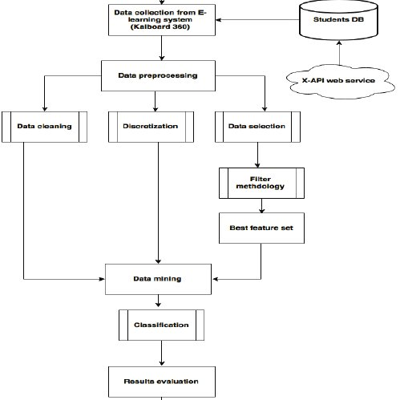
ARCHITECTURAL REPRESENTATION

Slide 11
UML DIAGRAM
A Unified Modeling Language is a diagram with the purpose of visually representing a system along with its main actors, roles, actions, artifacts or classes, in order to better understand, alter, maintain, or document information about the system
Need for UML Diagram
UML diagrams can be used as a way to visualize a project before it takes place or as documentation for a project afterward. But the overall goal of UML diagrams is to allow teams to visualize how a project is or will be working, and they can be used in any field, not just software engineering.

Slide 12
Types of UML Diagram
Use Case Diagram
Class Diagram
Activity Diagram
State Chart Diagram
Sequence Diagram

Slide 13
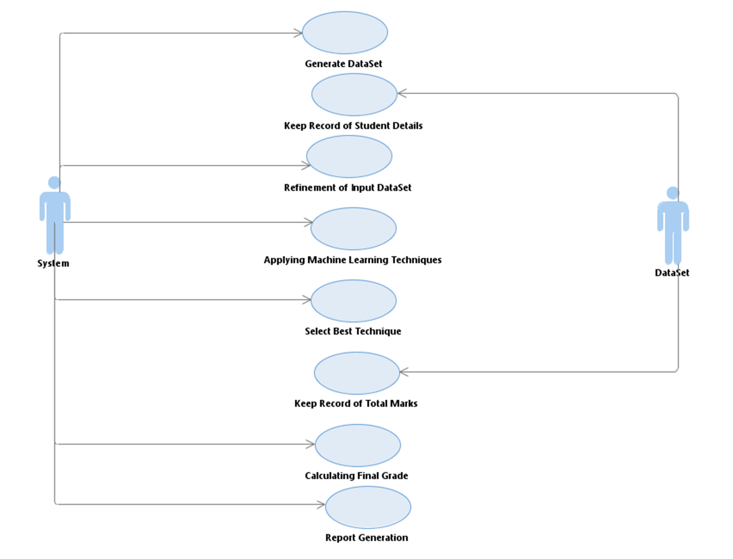
USECASE DIAGRAM
Use-case diagrams describe the high-level functions and scope of a system. These diagrams also identify the interactions between the system and its actors.

Slide 14
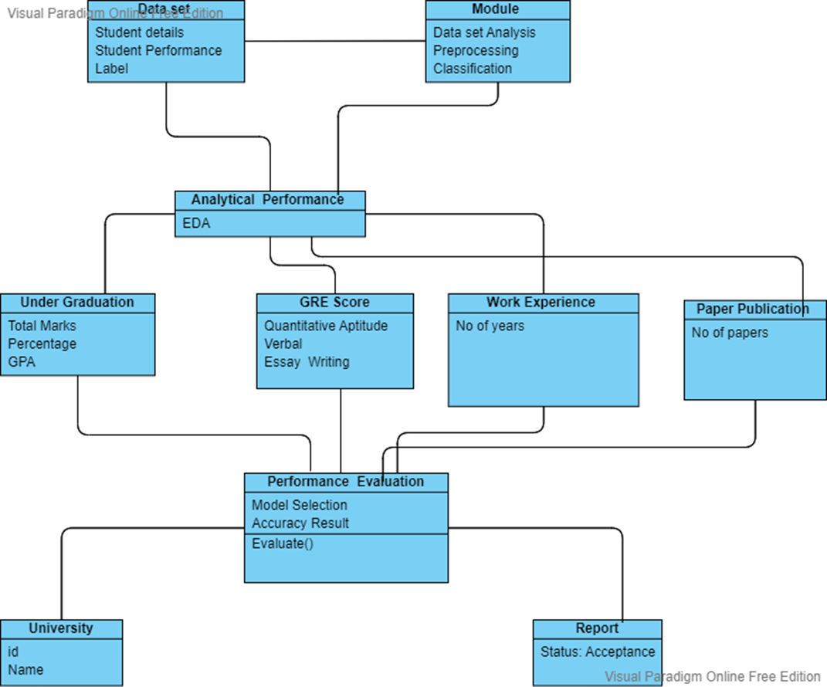
CLASS DIAGRAM
Class diagram is a static diagram. It represents the static view of an application. Class diagram is not only used for visualizing, describing, and documenting different aspects of a system but also for constructing executable code of the software application.

Slide 15
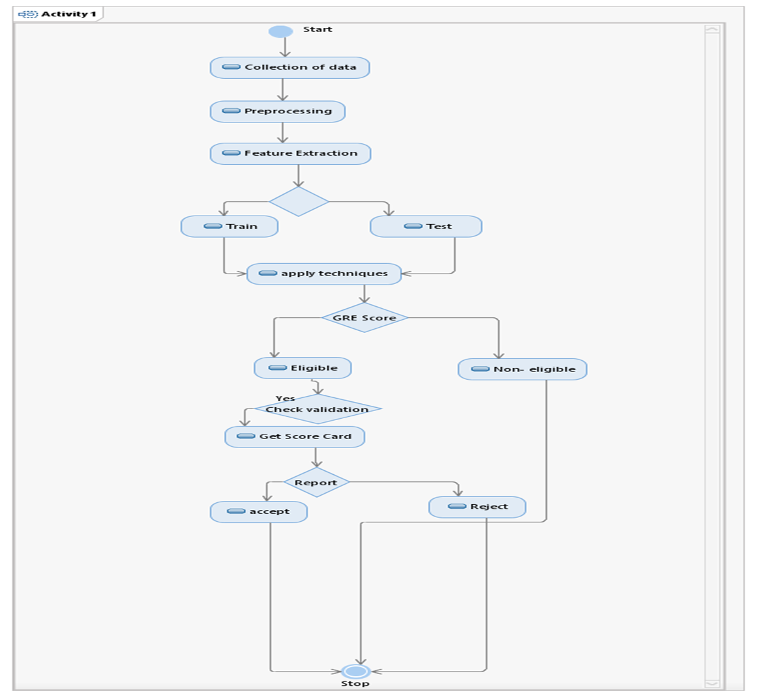
ACTIVITY DIAGRAM
Activity diagram visually presents a series of actions or flow of control in a system similar to a flowchart or a data flow diagram. Activity diagrams are often used in business process modeling.

Slide 16
STATE CHART DIAGRAM
State chart diagram describes the flow of control from one state to another state. States are defined as a condition in which an object exists and it changes when some event is triggered. The most important purpose of State chart diagram is to model lifetime of an object from creation to termination.

Slide 17
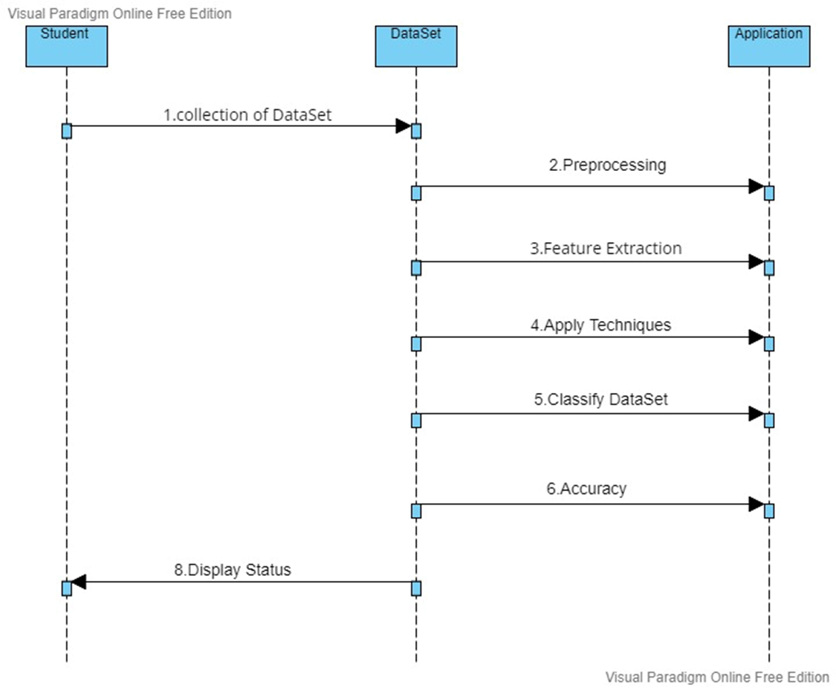
SEQUENCE DIAGRAM
A sequence diagram is structured in such a way that it represents a timeline which begins at the top and descends gradually to mark the sequenceof interactions.

Slide 18
ALGORITHMS
In our proposed system we are using the following algorithms:
•Artificial Neural Network
•Naive Bayes
•Decision Tree
•Support Vector Machine
•Random Forest

Slide 19
ARTIFICIAL NEURAL NETWORK
Neural networks, also known as artificial neural networks (ANNs) or simulated neural networks (SNNs), are a subset of machine learning and are at the heart of deep learning algorithms. Their name and structure are inspired by the human brain, mimicking the way that biological neurons signal to one another.
Artificial neural networks (ANNs) are comprised of a node layers, containing an input layer, one or more hidden layers, and an output layer. Each node, or artificial neuron, connects to another and has an associated weight and threshold. If the output of any individual node is above the specified threshold value, that node is activated, sending data to the next layer of the network. Otherwise, no data is passed along to the next layer of the network.

Slide 20
NAIVE BAYES
Naive Bayes algorithm is a supervised learning algorithm, which is based on Bayes theorem and used for solving classification problems.
It is mainly used in text classification that includes a high-dimensional training dataset.
Naïve Bayes Classifier is one of the simple and most effective Classification algorithms which helps in building the fast machine learning models that can make quick predictions.
It is a probabilistic classifier, predicts on the basis of the probability of an object.

Slide 21
DECISION TREE
Decision tree algorithm falls under the category of supervised learning. They can be used to solve both regression and classification problems.
Decision tree uses the tree representation to solve the problem in which each leaf node corresponds to a class label and attributes are represented on the internal node of the tree.
We can represent any boolean function on discrete attributes using the decision tree.

Slide 22
SUPPORT VECTOR MACHINE
Support Vector Machine or SVM is one of the most popular Supervised Learning algorithms, which is used for Classification as well as Regression problems.
SVM algorithm is used to create the best line or decision boundary that can segregate n-dimensional space into classes so that we can easily put the new data point.
SVM chooses the extreme points/vectors that help in creating the hyperplane.

Slide 23
RANDOM FOREST
Random Forest is a popular machine learning algorithm that belongs to the supervised learning technique. It can be used for both classification problems in machine learning.
It follows “ensemble learning” which is a process of combining multiple classifiers to solve a complex problem and to improve the performance of the model.
“Random Forest is a classifier that contains a number of decision trees on various subsets of the given dataset and takes the average to improve the predictive accuracy of that dataset.”

Slide 24
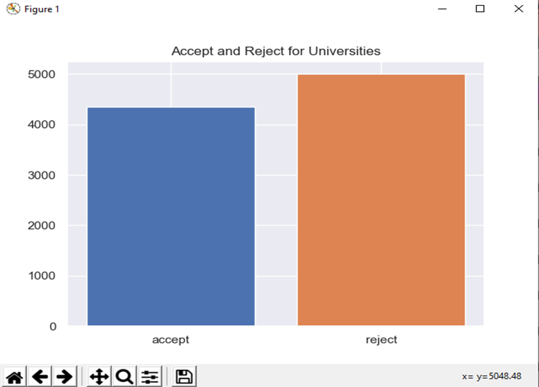
OUTPUTS

Slide 25
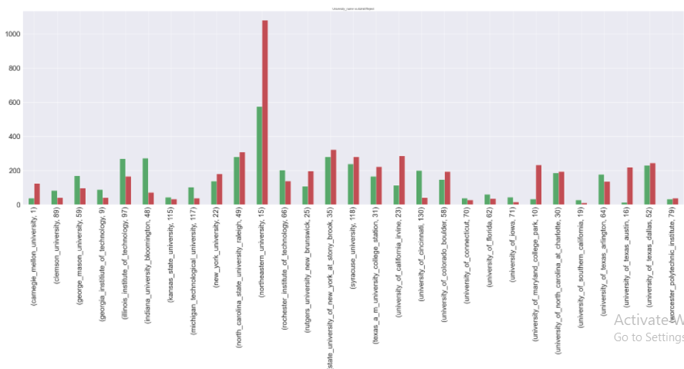
VISUALIZE DATA FOR BETTER UNDERSTANDING

Slide 26
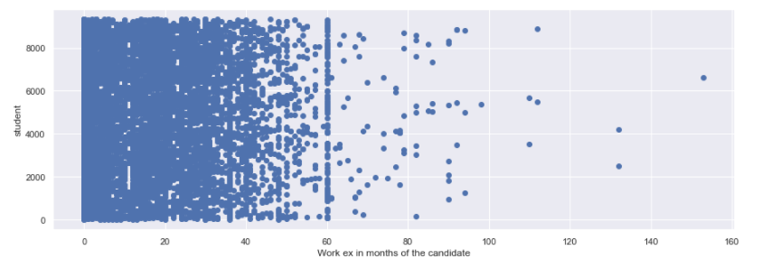

Slide 27
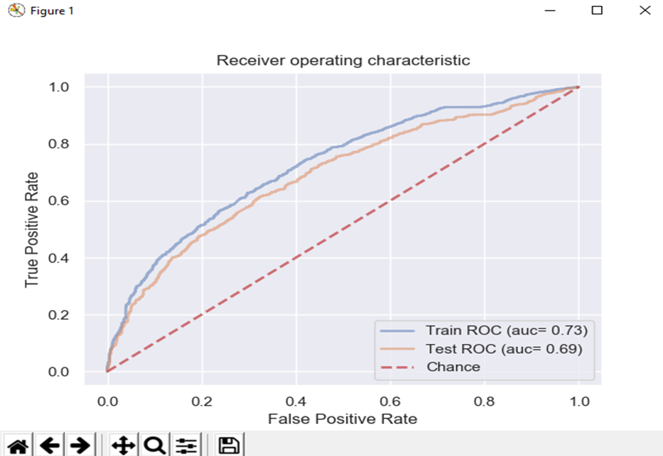
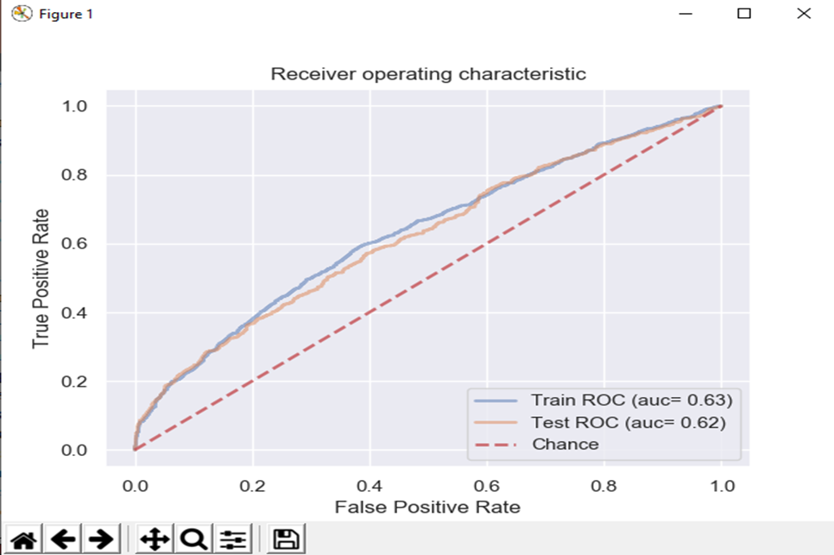
GRAPHICAL REPRESENTATION

Slide 28
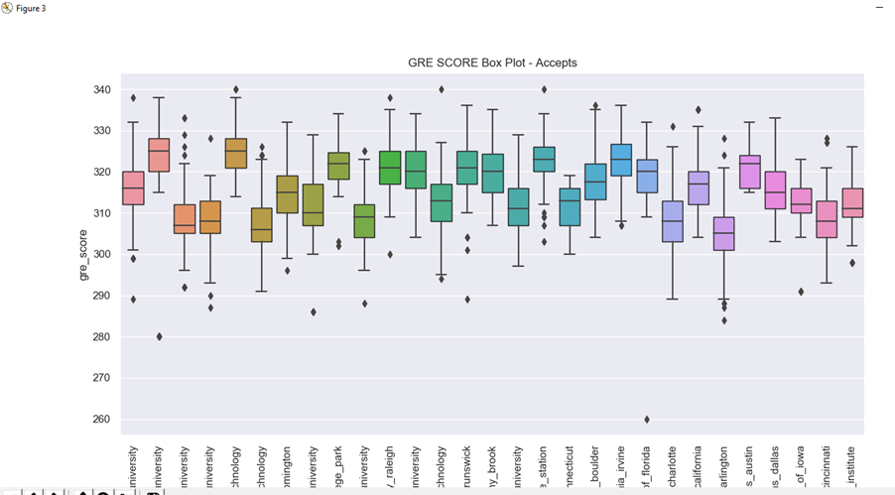
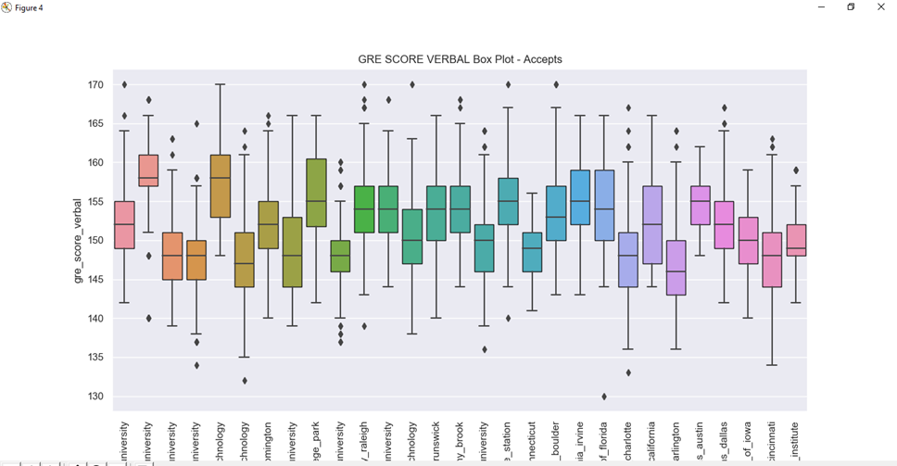

Slide 29
CONCLUSION
The meta-analysis on predicting students’ performance has motivated us to carry out further research to be applied in our environment. The educational system to monitor the students’ performance in a systematic way for improving the prediction find out enhanced prediction model by reviewing and compared the many existing techniques. This project has presented an exhaustive survey of research works on Educational data mining. Clustering techniques provides various useful factors and it can be multilevel non-hierarchical and hence the researchers must carefully choose the algorithm and the variables that result in better and accurate clusters and hence provide useful information.

Slide 30


Slide 31

ANY QUERIES??

